Slide 1

Genome variation and function 2
Marie Saitou
Assistant Professor, CIGENE, BIOVIT
17. Oct. 2022

Slide 2
Learning Outcomes
Prologue - Current topics in genomics
Human genome sequence
Nobel prize 2022
We will learn about:
Methods and significance of functional genomics
Challenges of genomics

Slide 3
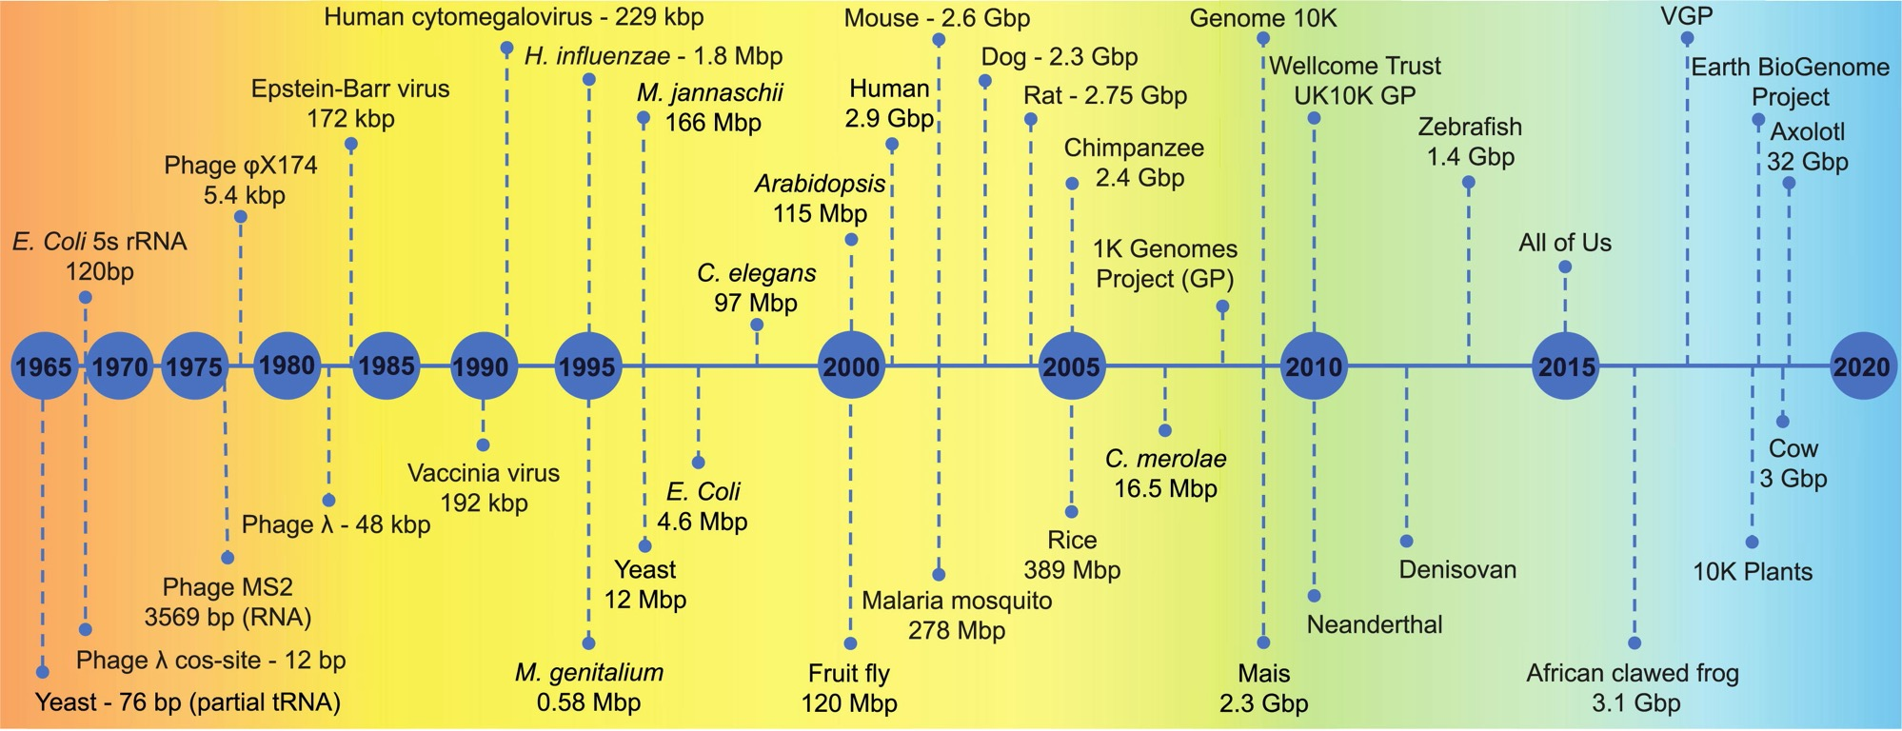
Brief Review: The timeline of genomics
https://www.sciencedirect.com/science/article/pii/S2001037019303277

Slide 4
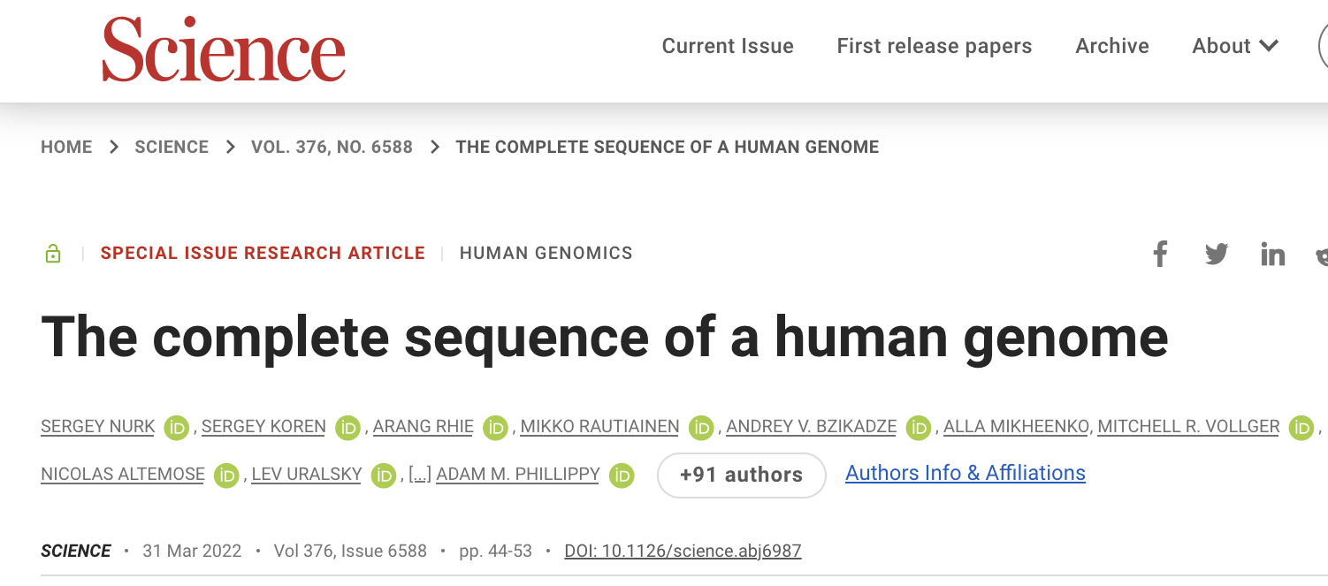
The complete human genome (2022)
https://www.biorxiv.org/content/10.1101/2021.05.26.445798v1.full
Adds nearly 200 million base pairs to the 2013 version of the human genome sequence.
Lasers to scan long stretches of DNA isolated from cells — up to 20,000 base pairs at a time. (PacBio)
Insight into traits/disease/evolution with further studies

Slide 5
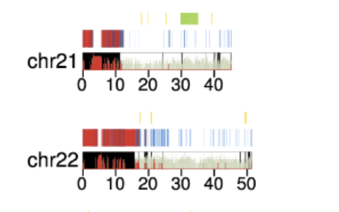
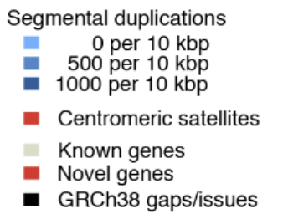
Adds nearly 200 million base pairs to the 2013 version of the human genome sequence.

Slide 6
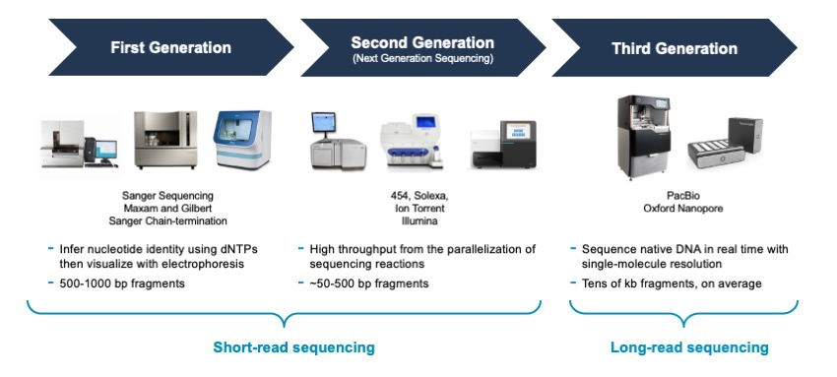
The latest technology
https://www.pacb.com/blog/the-evolution-of-dna-sequencing-tools/

Slide 7
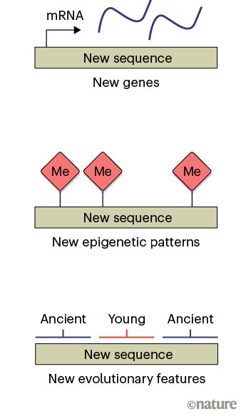
Evolution/Function/Disease...
New genes, epigenetic patterns and evolutionary features to be identified in previously unseen regions
https://www.nature.com/articles/d41586-021-01095-8

Slide 8
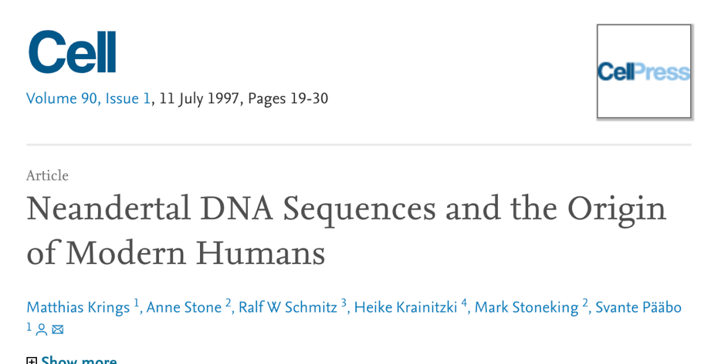
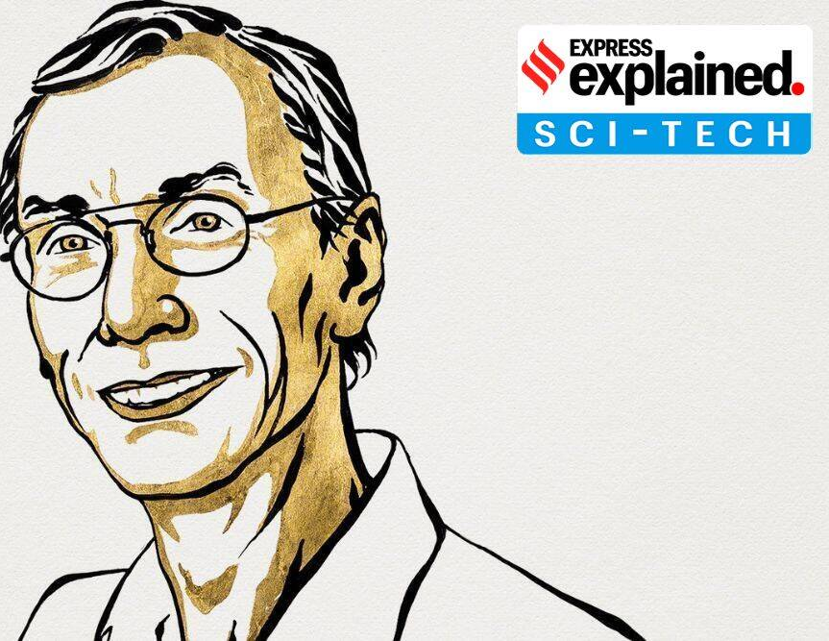
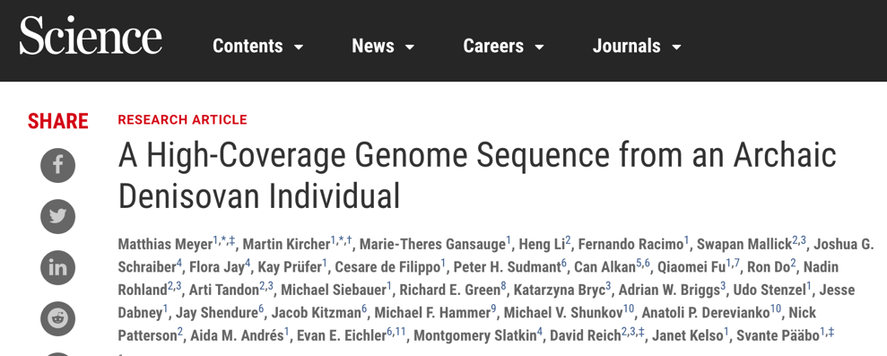
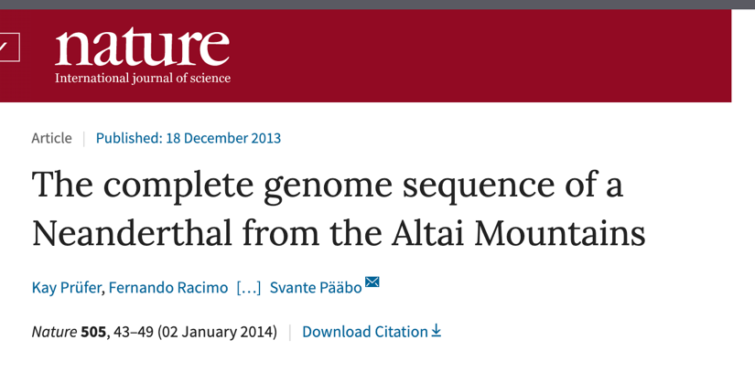
Ancient human genomics
1997
2012
2014
Nobel Prize in Medicine, 2022

Slide 9
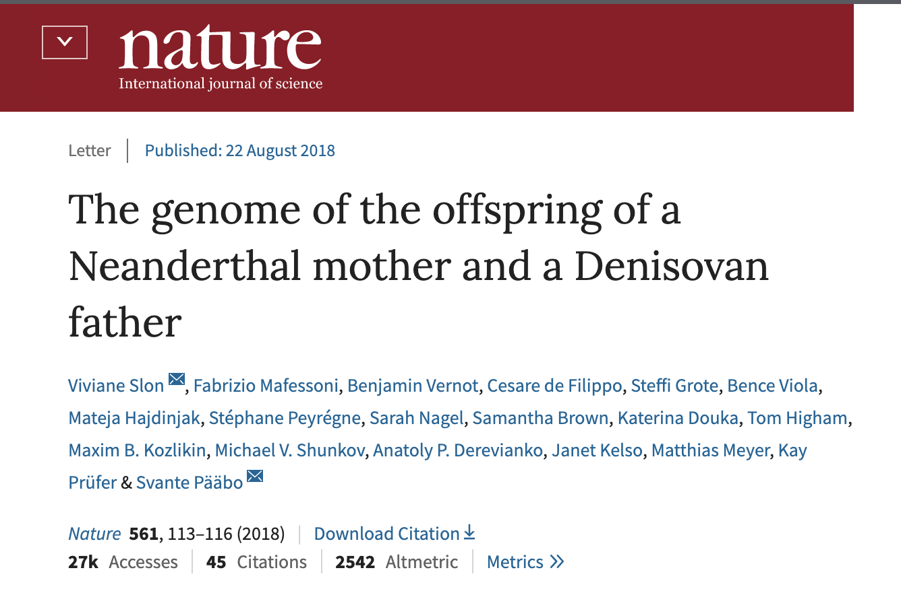
Archaic Hominins

Slide 10
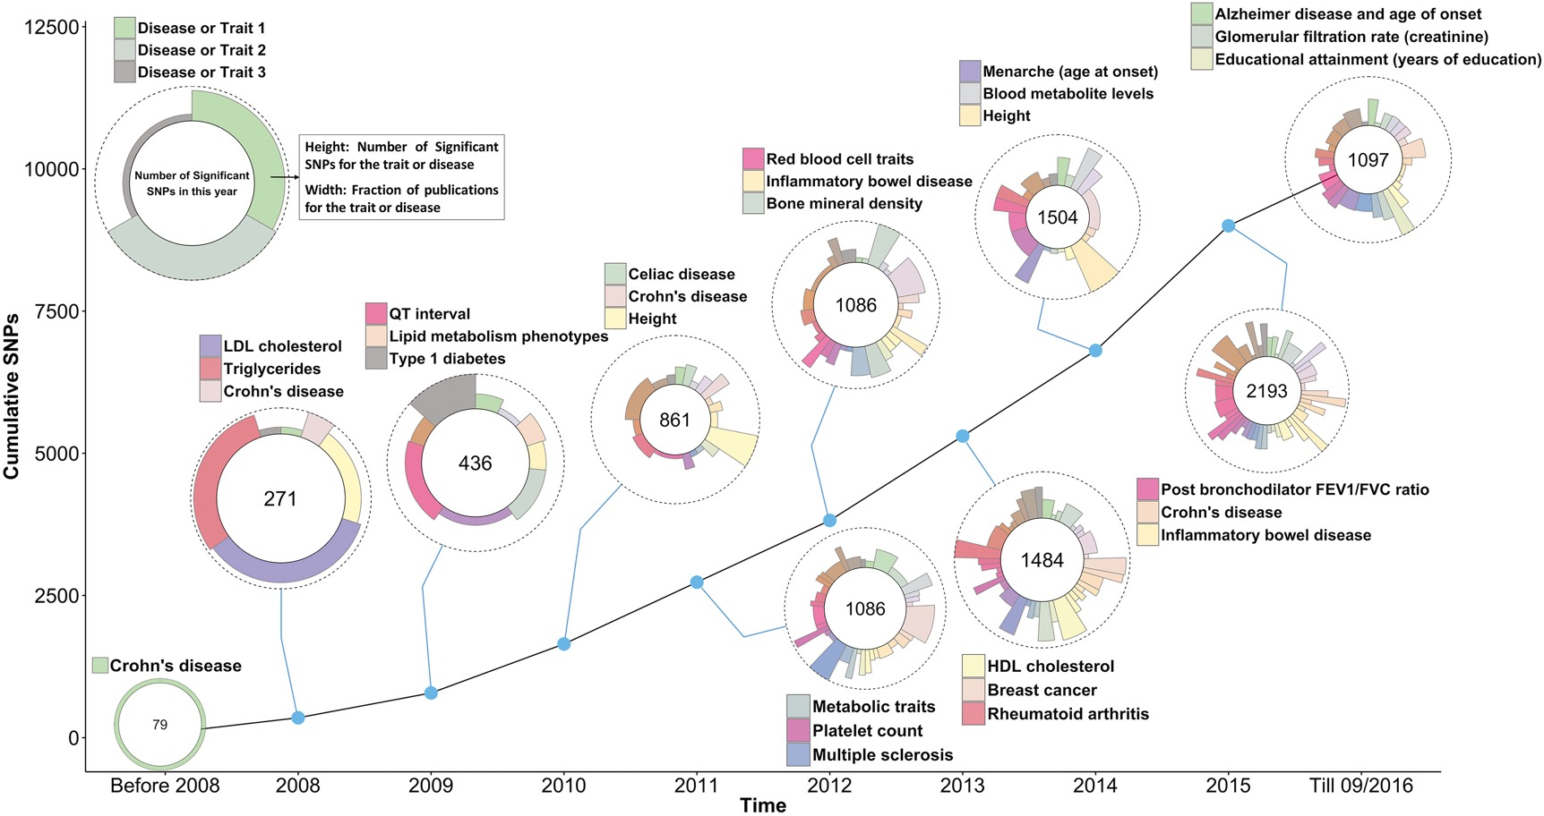
10 Years of genome-wide association studies
Visscher et al., 2017

Slide 11
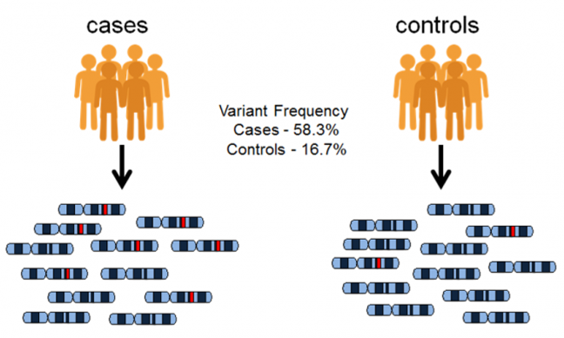
Genome-wide association study (GWAS)

Slide 12
GWAS – estimate the association between the phenotype and all observed variants
AA
AT
TT

Slide 13
How to read a Manhattan plot – a GWAS result representation
variants
-log₁₀(p-value)
chromosomes

Slide 14
What is the p-value in GWAS?
the probability of obtaining results as extreme as the observed results of a statistical hypothesis test, assuming that the null hypothesis is correct.
alternative hypothesis: the variant is associated with the trait
null hypothesis: the variant is not associated with the trait

Slide 15
Multiple comparisons problem
However, 2hen you conduct the GWAS for 100 variants, 5 of the genes can show p < 0.05 under the null hypothesis.
-> When you conduct the for 10,000 variants, 500 of the genes can show p < 0.05 under the null hypothesis (randomly, by chance).
There are various ways to “correct” this problem, considering how many times one conducts the same comparison.
Example:
Bonferroni correction - the local significance level is divided by the number of tests performed.

Slide 16
Why genome-wide analysis is beneficial
Most quantitative traits are influenced by many genetic variants each with small effects
GWAS can identify these individual genetic loci with small effects in a large enough sample
Polygenic score/breeding value predicts phenotype based on genomic information aggregating the small effect of genetic variants

Slide 17
Desirable traits: mostly polygenic traits Polygenic traits vs Mendelian traits
Mendelian traits: shaped by a single gene alone.
example: Wet or dry earwax, Face freckles
Polygenic traits: influenced by multiple (~ thousands) genes.
example: Hair color, height and most of quantitative (continuous) traits
Notes:
https://www.genome.gov/dna-day/15-ways/agriculture

Slide 18
Polygenic trait: example (three loci, A, B and C affect color)
aabbcc (light color)
x
AABBCC (dark color)
AaBbCc (intermediate)
genotype and color

Slide 19
Limitation of genome-wide association studies
The difficulty in figuring out true causal associations
They tell us statistical associations, not biological mechanisms

Slide 20
The difficulty in figuring out true causal associations
- Linkage Disequilibrium

Slide 21
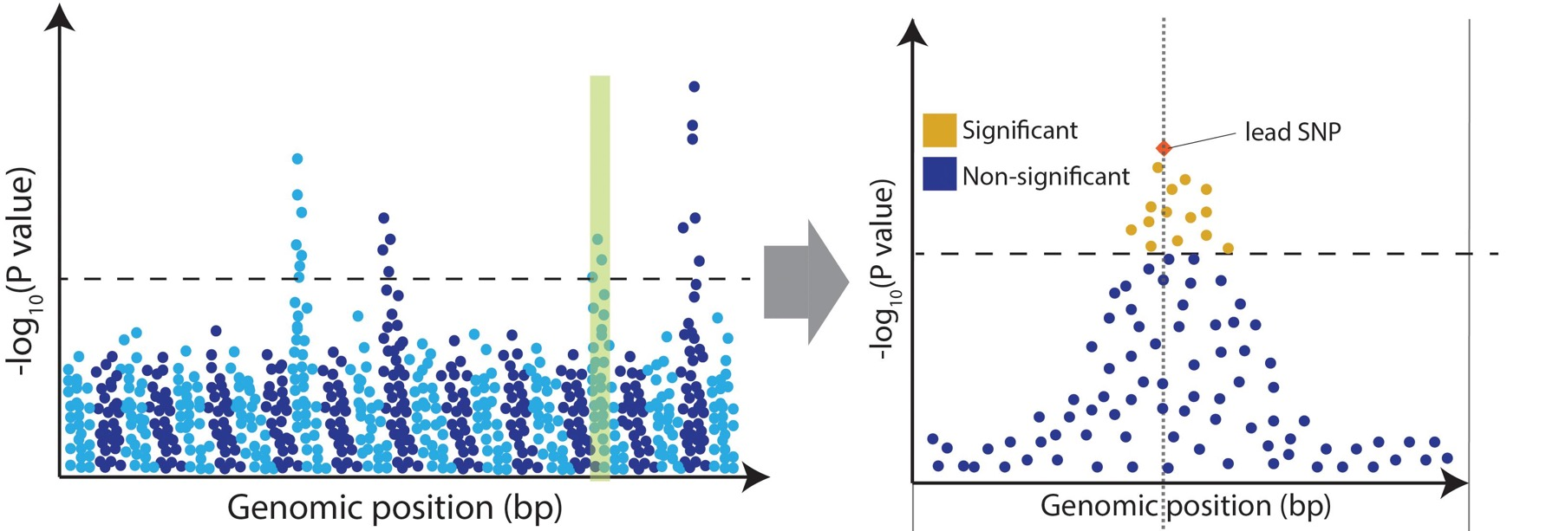
The difficulty in figuring out true causal associations
https://www.frontiersin.org/articles/10.3389/fgene.2020.00424/full

Slide 22

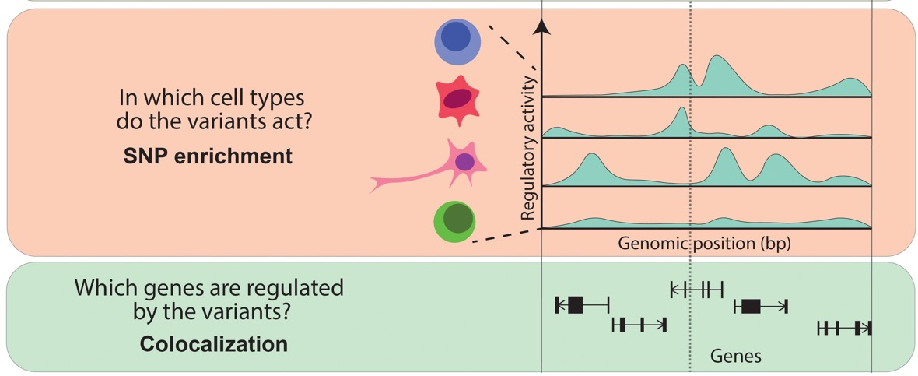
Multi-omics approach to narrow down causal associations

Slide 23
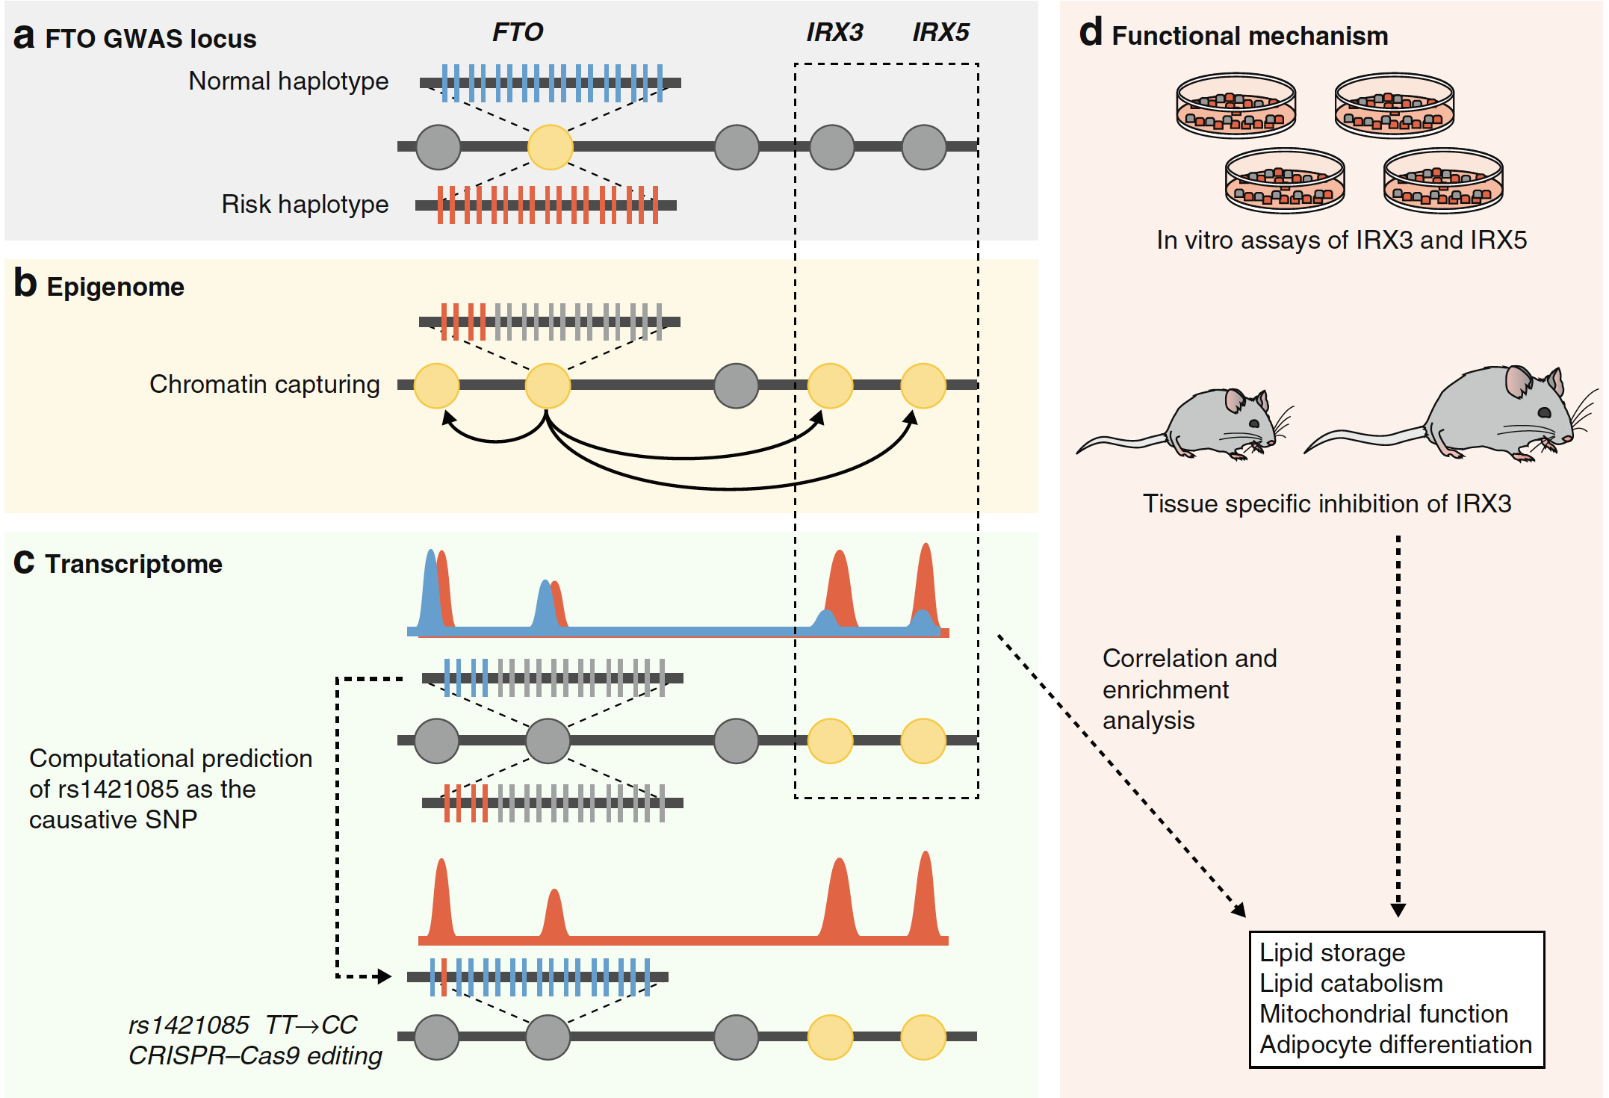
Multi-omics approach to narrow down causal associations
https://genomebiology.biomedcentral.com/articles/10.1186/s13059-017-1215-1

Slide 24

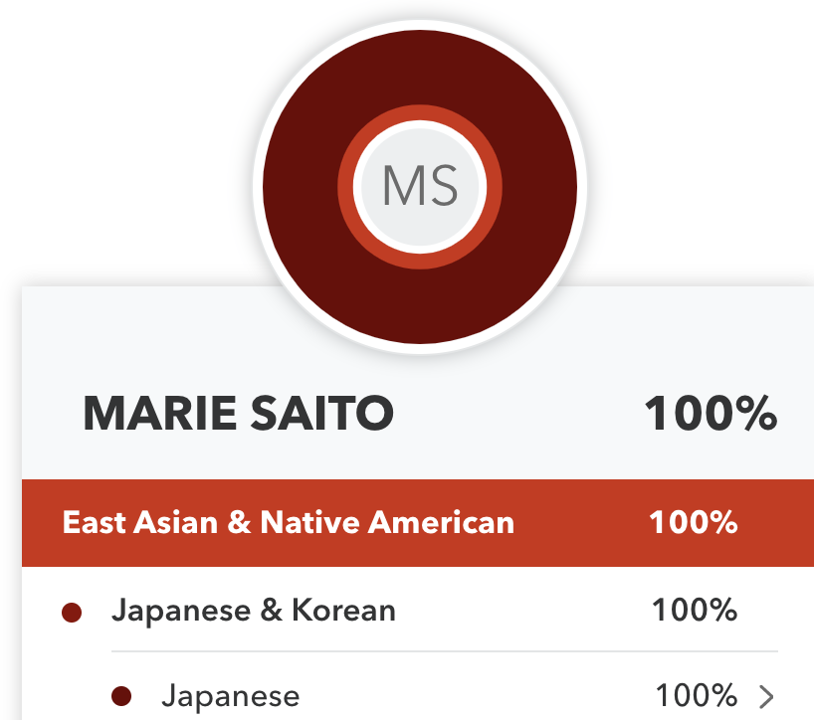
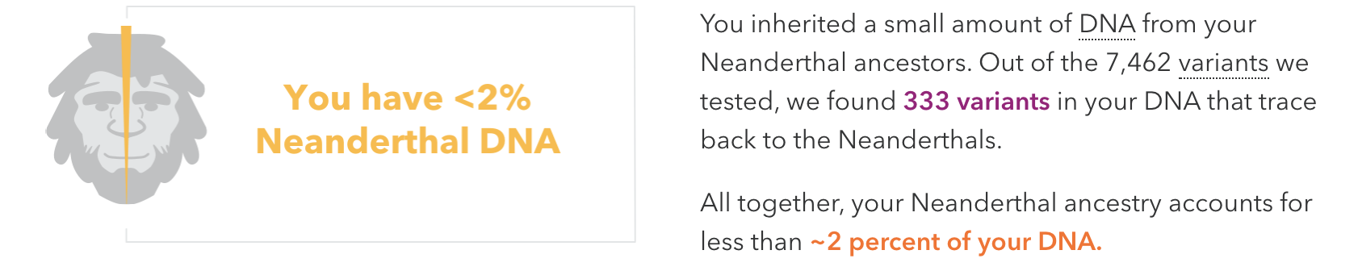

Commercial DNA test

Slide 25
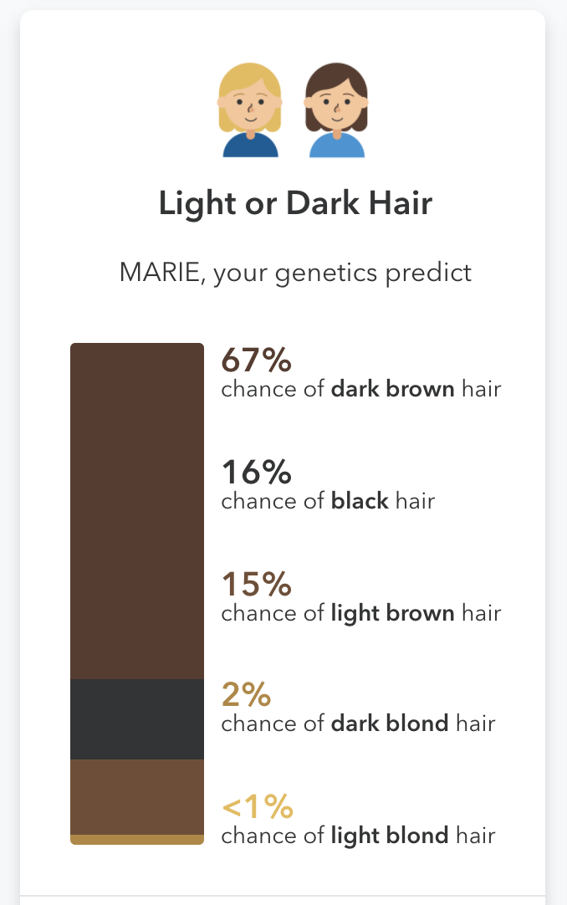
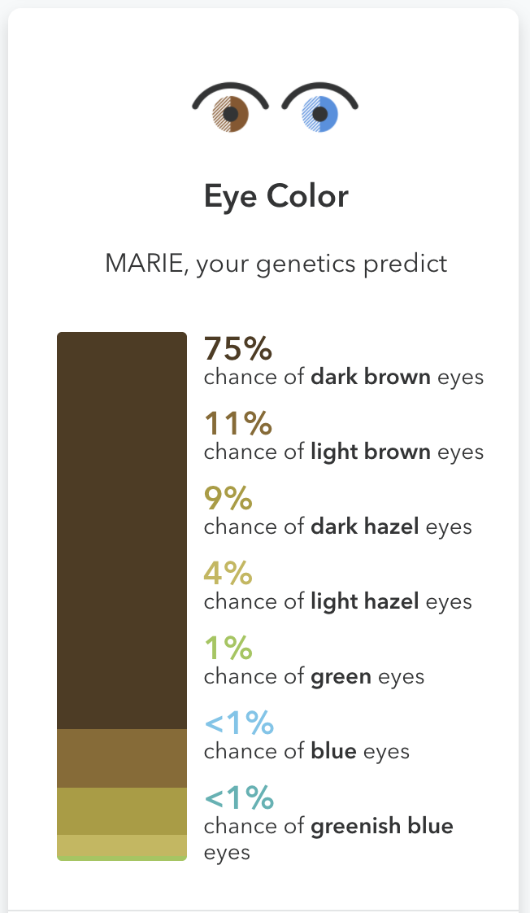

Slide 26
Ethics
Equity
Privacy
Literacy
XX% of all GWAS participants are of European descent despite making up only 16% of the global population

Slide 27
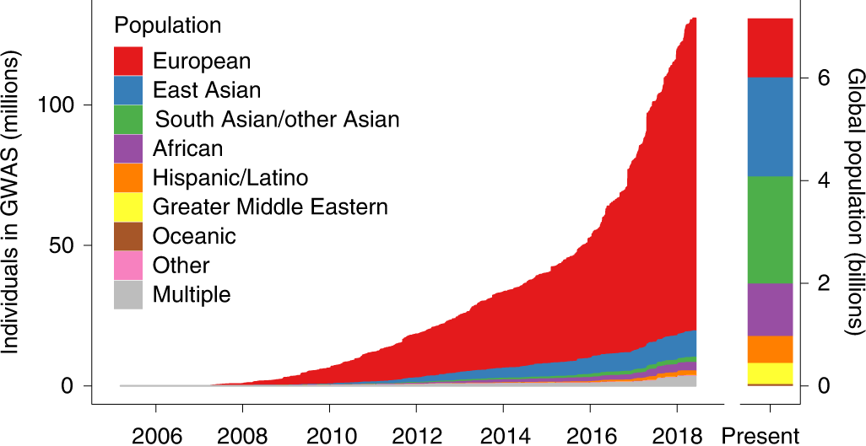
“human genomics must be more equitable and more open”
~79% of all GWAS participants are of European descent despite making up only 16% of the global population
https://doi.org/10.1038/s41588-019-0379-x

Slide 28

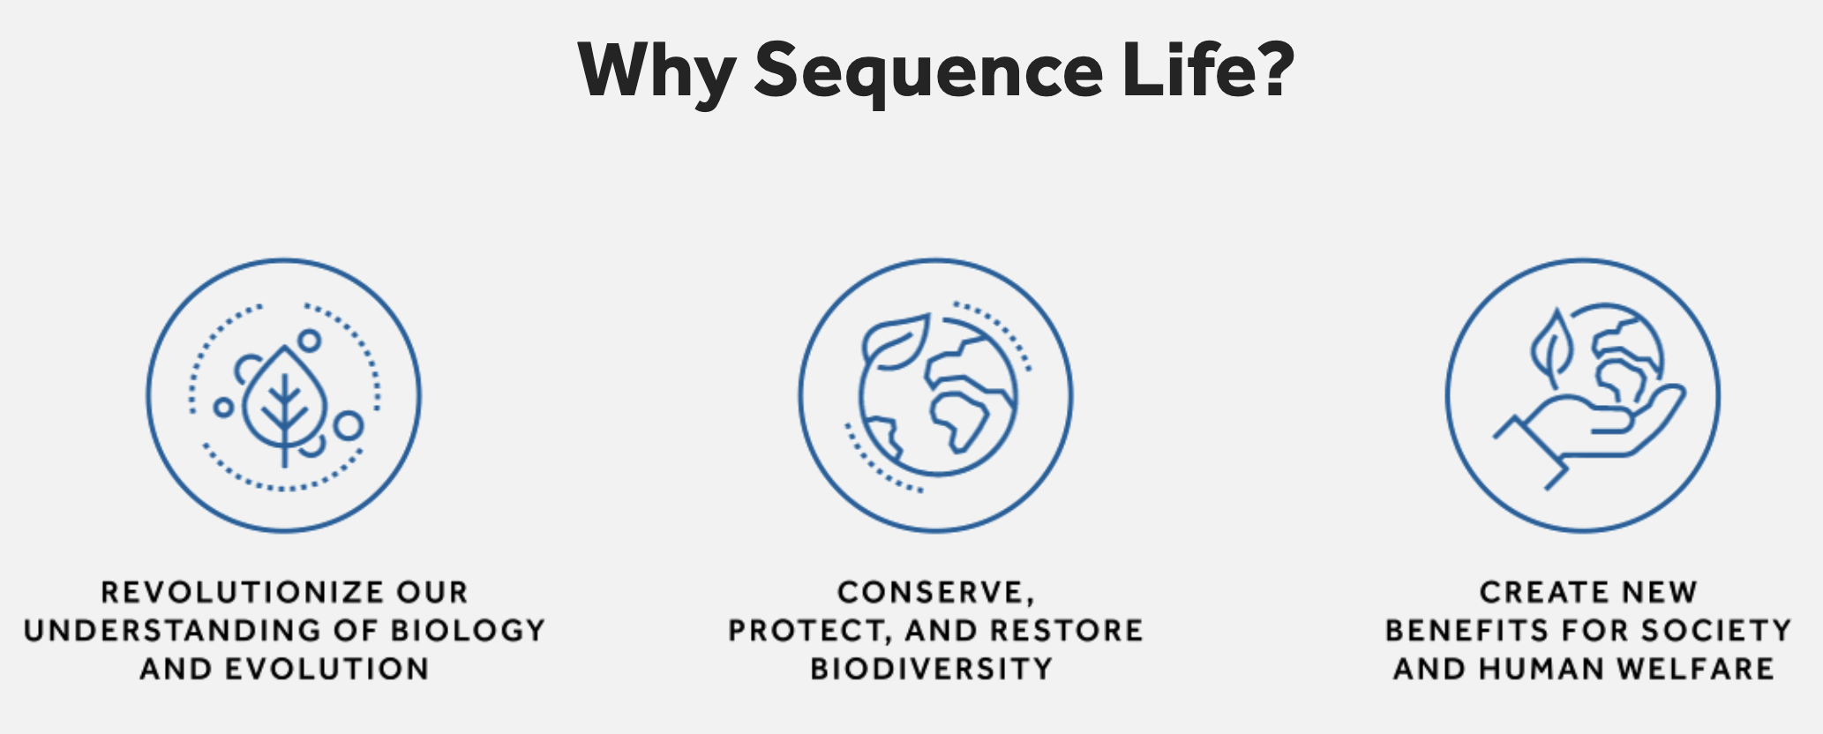
... not only humans.
The Earth BioGenome Project (EBP), aims to sequence, catalog and characterize the genomes of all of Earth’s eukaryotic biodiversity over a period of ten years.

Slide 29
Hands-on exercise

